Slide 1
Corporate Event Planning

Slide 2
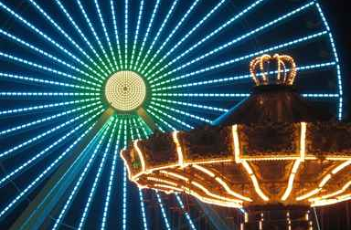
Treat your employees to a private party for an evening of rides, games, food, and fun at a Sensation Park amusement park.

Slide 3
Event Information

Slide 4
Corporate Party Packages
High Flyer
Dinner and dessert
Indoor dance floor and DJ
Adults only
Park Picnic
Barbecue buffet
Available in summer
All ages
Family Evening
Dinner and dessert

Slide 5

Contact Sensation Park Corporate Event Planning for Additional Information

